Slide 1
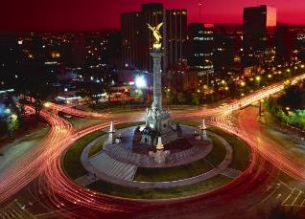
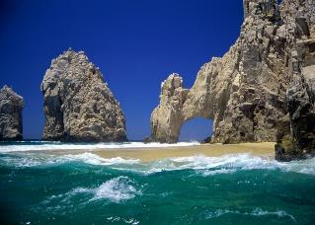
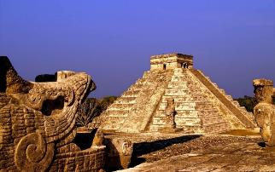
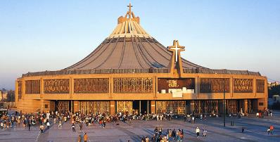
EXTRAORDINARY GENERAL ASSEMBLY OF THE ICCFM
The Angel of independence of Mexico City
The Cabos Baja California Sur
Pre-Hispanic City of Chichén Itzá
Yucatán
Basilica of Guadalupe city of Mexico
DIOCESE OF QUERÉTARO, MEXICO.
31 January, 1 and 2 February 2014.

Slide 2
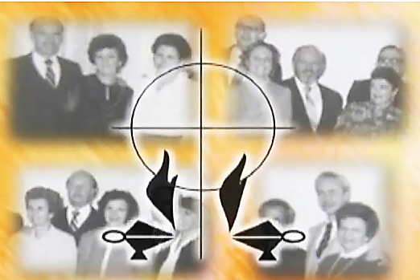
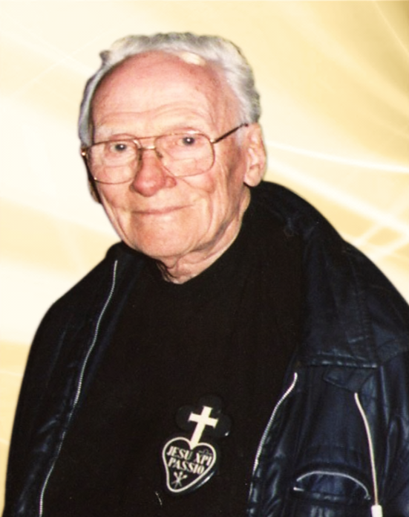
MFC IN MEXICO
Alfonso and Cristi Noriega, Ignacio and Enriqueta Toussaint, Rafael and Consuelo González Rivas, contemplating to Joseph and Luzma Álvarez lcaza as the first National Presidents.
On November 5, 1958, the hierarchy of the Catholic Church of Mexico officially designates the first Coordinator national team composed of two marriages of father Marín group and two from the Group of the parent Hernández:

Slide 3
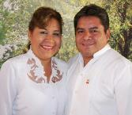
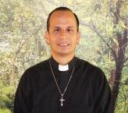
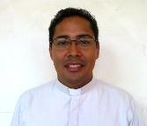
TEAM COORDINATOR NACIONAL CONFORMADO BY:
Rafael and Raquel Vivian Hernandez
National Presidents
Pbro. Oliver César Villalobos Tecalco
Advisor Ecclesial
Pbro. Guadalupe Serrano Rosas
Advisor Ecclesial youth presidential
term: 2013-2016 E-mail: rafa_220265@live.com profa_raquel44@homail.com

Slide 4
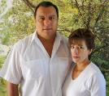
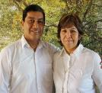
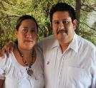
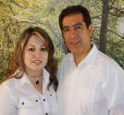
AREA I the MFC and his Mystic
HUGO AMARO and FLOR GARCIA
e-mail: huamco@Hotmail.com
AREA II the MFC committed with the community
CARLOS ALCANTARA and grace CASTILLO
e-mail: carlosygracia@Hotmail.com
AREA III the justice and solidarity in the MFC
RAFAEL REYES and CONSUELO CARVAJAL
e-mail: mfctres_nal@Hotmail.com
AREA IV the unit and stewardship in the MFC
JESUS RAMOS and BLANCA SASTRE
mail: egogaius@Hotmail.com

Slide 5
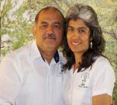
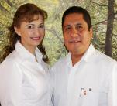
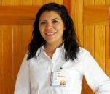
AREA V PRIESTLY ASSISTANCE IN MFC.
EUSTOLIO RGUEZ. AND MA. GPE. MALAGÓN
e-mail: nogepul65@Hotmail.com
AREA VI youth promotion of MFC.
MIGUEL VAZQUEZ SARA White
email: misajuvenilmfcnac@hotmail.com
young National Coordinator.
YOSHIRA candle PORTELA
e-mail: yoshirita31@Hotmail.com

Slide 6
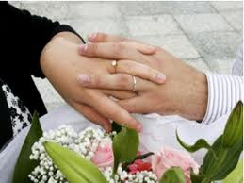
A. SU SER
I. MÍSTICA
Carisma
Spirituality conjugal and consequently the family apostolate as a means of sanctification of the family.

Slide 7

Misión
Provide couples and young people an integral evangelization which includes educational, dynamic, progressive and systematic training through which human and Christian values are promoted you learn to talk and provided means and instruments to promote that their families are: real people, server of life communities, promoting the common good and a place where Holiness is sought.

Slide 8

Visión
Build the Kingdom of God from the families, so that they will announce, celebrate and serve the Gospel of marriage, family and life, and families to be leaven of Christian life in their community.

Slide 9
Valores
The Christian Family Movement believes that the family carries with it the future of the person and of society and that the future is brewing every day from the Gospel values.

Slide 10
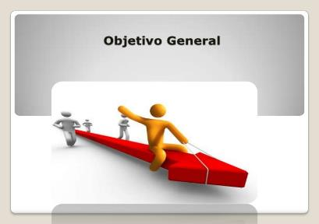
II. OBJETIVOS
Objetivo General
"Promote the values human and Christian family in the community, so the family is forming of people, educating in the faith, defender of life and, therefore, actively committed to the integral development of the community through its members"

Slide 11
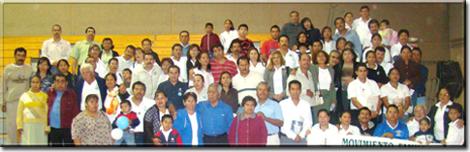
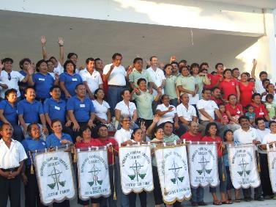
III. CARACTERÍSTICAS
We are a movement, movement means life; life means people who breathe, feel, think, love, hope, strive, seek and advance.

Slide 12
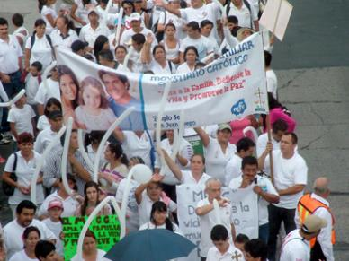
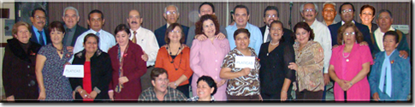
III. CARACTERÍSTICAS
We are a family movement We have a common vocation. We share ideals and concerns. This is our first common characteristic. It is what makes that we begin to "move" together to form a 'movement'

Slide 13

III. CARACTERÍSTICAS
We are a Christian family movement
By movement, colloquial and being a Christian, MFC is a place where we can find an experience of fraternity; and an experience of God manifested among us, filling us with his spirit, bringing us in Christ.

Slide 14
B. SU VIDA
I. PROCESS OF GROWTH OF THE MFC AND METHODOLOGY OF THE PROCESS.
During the months of January to may each year be capture young couples to experience the zero level.
In May and June is an intense promotion through brochures, posters, etc.
In the months of July and August is taught pre-registration cycle all marriages and young people captured, including who attended the zero level.

Slide 15
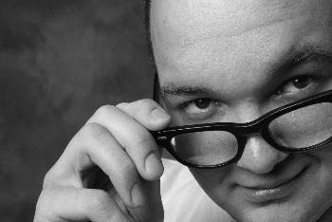
NIVEL ZERO
JUSTIFICATION OF THE THEMES
They are based on human values and Christian, very in keeping with our goal
They do not require a specific sequence
Are easily assimilated and encourage participation
TOPICS OF LEVEL ZERO
Are not reiterated themes that you will live in the CBF

Slide 16

NIVEL ZERO
Reunión de presentación.
Tema 1: Tolerancia y Respeto.
Tema 2: Prudencia.
Tema 3: Fortaleza.
Tema 4: Responsabilidad.
Tema 5: Justicia.
Tema 6: Humildad.
Tema 7: Voluntad.
Tema 8: Trabajo y Estudio.
Tema 9: Solidaridad.
LAS DIEZ REUNIONES
VALORES

Slide 17
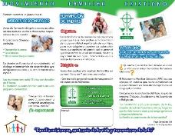



PROMOCIÓN INTENSA
Campaign national 1 + 1, is to promote that each Member, marriage or young, undertakes to register one member.
This strategy is supported with the delivery of a bracelet to who complies with the above. In addition to promotional brochures, posters, and videos.
All of this website
(www.mfcmexico.org/).

Slide 18
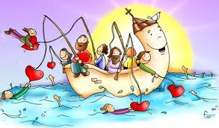
DIFFERENT PROMOTION STRATEGIES
LEVEL ZERO
EQUIPMENT MORE EQUIPMENT
IN PARISHES INVITATION
INFORMATION MATERIAL OF THE MFC BROCHURES, POSTERS, LEAFLETS, ETC.
PERSONALIZED INVITATION (HOUSE-TO-HOUSE)
PROMOTIONAL POSTERS, RADIO SPOTS AND TV
BENEFICIARIES OF TRAINING FOR PARENTS
VIDEOS OF TESTIMONIES
INVITATIONS ON BOARDS OF PARENTS IN CATHOLIC SCHOOLS
LIST OF BENEFICIARIES OF THE CPIM.
MEETING WITH PARENTS OF THE DIOCESAN NEWSPAPER YOUTH
PROMOTION IN YOU TUBE PAGE ON SOCIAL NETWORKS

Slide 19
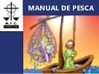
PRE-REGISTRATION CYCLE
The couple attends three team meetings, which explores the brochure our team, to have a general idea of what the movement, what offers and what to expect from it. Live meetings, knows firsthand the life of MFC, meets its objective, its opportunities, its media and instruments.

Slide 20

II. THE SPIRIT OF THE FORMATION IN THE MFC.
To meet its objective, the MFC has various means and instruments of formation, of which the principal is the basic cycle of training (CBF).

Slide 21


(Encuentros).
Experience of the strong moments
The CBF for marriages, (3 years) there are three special moments: meeting of basic evangelization (Kerygma), Encuentro conjugal and family encounter.
The CBF for young people and adolescents, there are two special moments that must live and which are: Kerygma and youth.
The Kerygma aims to raise or rekindling the faith and conversion in the MFC members.

Slide 22
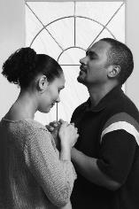
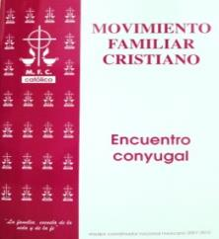
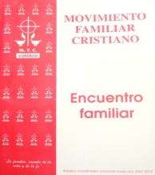
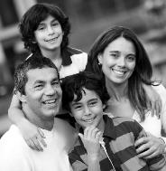
Encuentro Conyugal
  The objective of the spousal meeting, is to promote deep dialogue and the relationship between the spouses.
Encuentro Familiar
The aim of the family encounter, is to promote dialogue and the relationship between the members of the family.

Slide 23
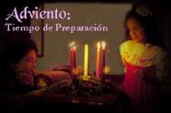
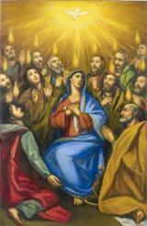
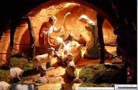
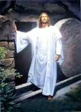
Experience of the moments of the liturgical cycle
The strong liturgical cycle times are considered in the CBF, are an essential part of the spiritual growth and formation of each marriage and a young member of the MFC.
For what they are:
1st. Meeting General of advent and Christmas.
2nd. Meeting General of lent and Easter.
3rd. Pentecost General meeting.
The subject to be treated is included in the books of the CBF.

Slide 24
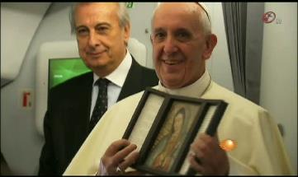
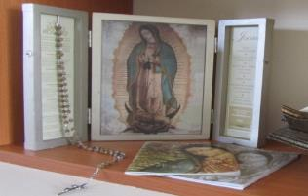
Recitation of the family rosary with the virgen Peregrina (strengthen the MFC)
OBJECTIVE: To promote prayer in the family through the prayer of the Holy Rosary, for Jesus our Lord, through the intercession of our mother the Virgin Mary, overflowing blessings abundant in households who visits La Virgen Peregrina.
One of the requests of the Richards father, deep mariano was: «that all the families of the MFC pray the Rosary daily»

Slide 25
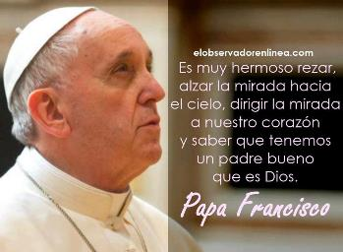
Constant prayer teams
.
¿From so that they could not stay awake even an hour with me? Are awake and pray that they do not fall into temptation. The spirit is bouncy, but the flesh is weak. Mt 26, 40-41
The primary objective of these teams is to be at the feet of the Lord in constant prayer, praising, thanking and begging for the needs of MFC, both Diocesan, provincial and national.
.

Slide 26

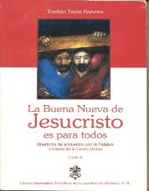

Discipleship through Lectio Divina
.
OBJECTIVE:
Strengthen, in the light of the document of Aparecida, the role of the disciple of all leaders of the MFC, achieving thus strengthen the structure that must ensure the full experience of the CBF from MFC.
Looking for deepening spirituality and strengthen the role of disciple in all MFC and MFCJ leader, study the word of God through Lectio Divina, aided by the introductory leaflet of the MFC and continuing with the books "The good news of Jesus Christ is for all" and "follow-up to the witness' the Pbro. Toribio Tapia Bahena

Slide 27
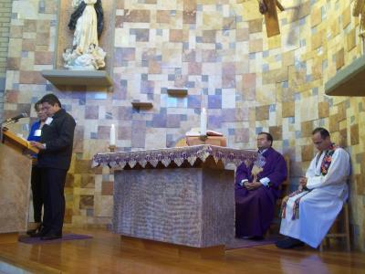
Experience of the monthly Eucharist.
Objective: Families of the MFC to take conscience that the Eucharist is source, Center and Summit of the Christian life, to celebrate it existentially and taking it the grace to persevere and to bear witness to life.
They participate as membership, of the monthly Eucharist. If it is not possible that it is only for membership, it is suggested to integrate with the parish community in one of the Sunday Eucharist.

Slide 28
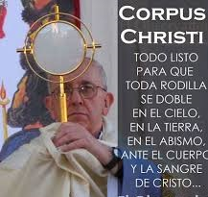
Vivencia de la Hora Santa
In the sentence "love is speaking" (Sta. Teresa). "Stay with me and stay awake" (Mt. 26.38).
Objective: That the families of the MFC may prostrate one hour before sacrament Jesus to worship and contemplate, for the offences of sinners, pray for priestly and religious vocations, as well as the needs of MFC.
You are invited to membership, to live and participate in the holy hour. Preferably the third Thursday of each month or when they may deem it suitable, according to parish activities.

Slide 29
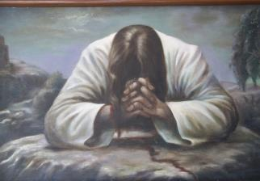
Proyecto de vida de oración
Objetivo:
Qué cada uno de los servidores genere un
PROYECTO PARTICULAR DE ORACIÓN,
para fortalecer su vida espiritual y servir con amor.
Cada servidor del MFC y MFCJ, anota en el formato, la disciplina espiritual que se proponga realizar, apoyándose de los ejemplos que se encuentran en la parte inferior del formato.

Slide 30
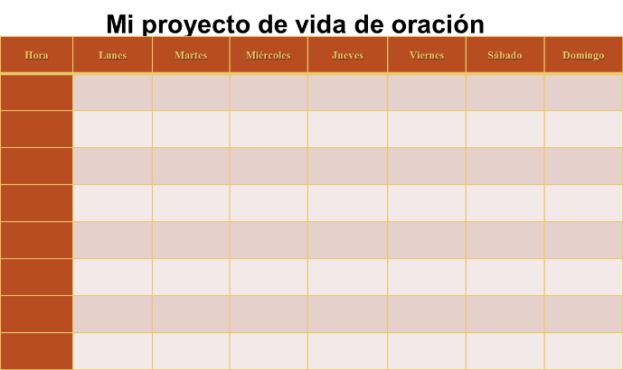
«Live praying and supplicating. Pray at all times as it will inspire them with the spirit. Ensure in common and persevere in your prayers ever, undaunted interceding in favor of all saints, his brothers.» Ef 6, 18
Examples: Eucharist, confession, holy hour, Rosary, liturgy of the hours (lauds, Vespers, complete), Angelus, Lectio Divina, fasting, visit to the Tabernacle, visit the sick, etc.

Slide 31
III. ORGANIZACIÓN Y ESTRUCTURAS.
BAJA CALIFORNIA
MEXICALI
TIJUANA
ENSENADA
BLOQUE I
Baja California
Hermosillo
Chihuahua
BLOQUE II
Monterrey
Durango
San Luis Potosí
Huasteca
MONTERREY
PIEDRAS NEGRAS
NUEVO LAREDO
MATAMOROS
MONTERREY
SALTILLO
LINARES
DURANGO
TORREÓN
GOMEZ PALACIO
DURANGO
EL SALTO
MAZATLÁN
HERMOSILLO
HERMOSILLO
OBREGON
CULIACAN
LA PAZ
SAN LUIS POTOSÍ
MATEHUALA
SAN LUIS POTOSÍ
ZACATECAS
AGUASCALIENTES
HUASTECA
CD. VICTORIA
TAMPICO
CD. VALLES
PAPANTLA
TUXPAN
CHIHUAHUA
CD. JUAREZ
TARAHUMARA
CHIHUAHUA
NVO. CASAS GRANDES
CUAUHTEMOC
PARRAL
BLOQUE V
Xalapa
Oaxaca
Chiapas
Yucatán
XALAPA
XALAPA
CORDOBA
ORIZABA
VERACRUZ
SAN ANDRES TUXTLA
TUXTEPEC
COATZACOALCOS
OAXACA
HUAJUAPAN
OAXACA
PUERTO ESCONDIDO
HUAUTLA
MIXES
TEHUANTEPEC
GUADALAJARA
EL NAYAR
COLIMA
GUADALAJARA
AUTLÁN
CD. GUZMÁN
TEPIC
MORELIA
ZAMORA
MORELIA
TACÁMBARO
APATZINGAN
LÁZARO CARDENAS
BLOQUE III
Guadalajara
Morelia
Bajío
Hidalgo
CHIAPAS
TUXTLA GUTIERREZ
SAN CRISTOBAL
TAPACHULA
BAJÍO
SAN JUAN DE LOS LAGOS
LEÓN
CELAYA
IRAPUATO
QUERÉTARO
HIDALGO
HUEJUTLA
TULA
TULANCINGO
YUCATÁN
YUCATÁN
CHETUMAL-CANCÚN
CAMPECHE
TABASCO
BLOQUE IV
Acapulco
Puebla
México
Tlalnepantla
ACAPULCO
ACAPULCO
CHILPANCINGO-CHILAPA
CD. ALTAMIRANO
TLAPA
Presence of the MFC in 85 of the
90 dioceses complying in Mexico
MÉXICO
TOLUCA
ATLACOMULCO
CUAUTITLAN
MÉXICO
CUERNAVACA
TENANCINGO
TLALNEPANTLA
TEOTIHUACAN
TLALNEPANTLA
ECATEPEC
TEXCOCO
CD. NEZAHUALCOYOTL
VALLE DE CHALCO
PUEBLA
TLAXCALA
PUEBLA
TEHUACÁN

Slide 32
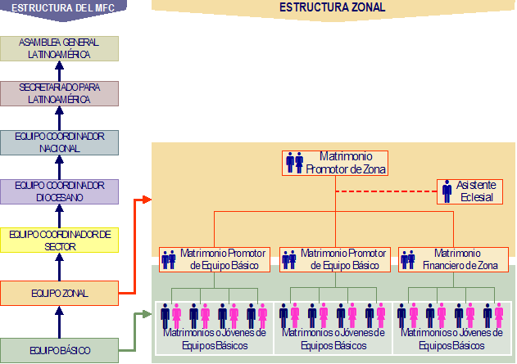

Slide 33
EQUIPOS DE LA DIRIGENCIA NACIONAL Y DIOCESANA
Presidentes
Secretarios Área I El MFC y su Mística
Secretarios Área II El MFC y la Comunidad
Secretarios Área III El MFC comprometido con la
Justicia y Solidaridad
Secretarios Área IV La Unidad y Corresponsabilidad
dentro del MFC
Secretarios Área V Asistencia Sacerdotal y
promoción en la fe.
Secretarios Área VI Promoción Juvenil dentro
del MFC
Joven
Sacerdote Asistente

Slide 34
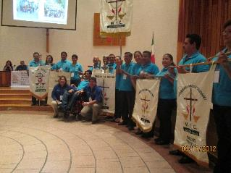
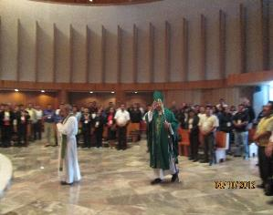
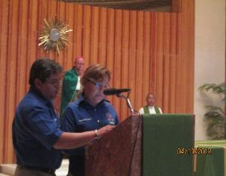

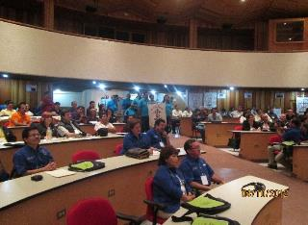
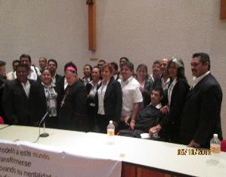
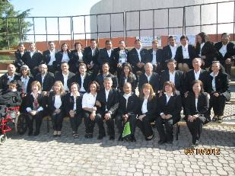
PREPARATION AND PARTICIPATION IN EVENTS
NATIONAL ASSEMBLY OCTOBER 04, 2012, CUAHUTITLAN IZCALLI, EDO. MEXICO, MEXICO.

Slide 35
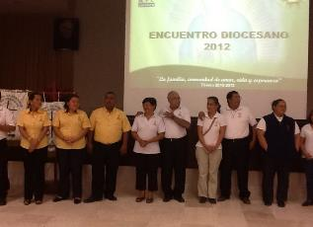





PREPARATION AND PARTICIPATION IN EVENTS
ENCOUNTERS DIOCESAN DECEMBER 2012, JANUARY 2013, XALAPA, MEXICO PROVINCE.

Slide 36
B. SU ACCIÓN APOSTÓLICA
WITHIN THE FAMILY NEEDS. (SERVICE OF TRAINING FOR PARENTS, LOVE TRAINING AND IMMEDIATE MARRIAGE PREPARATION COURSE).
THE MFC AND THE INCOMPLETE FAMILY. (SERVICE RESPONSIBLE OF MOTHERS FOR FAMILY).
THE MFC AND THE PASTORAL CARE OF FAMILIES IN FULL. (PROJECT OF THE NEW SERVICE TO THE SEPARATE RETURNED TO GET MARRIED)
REGRESAR

Slide 37




FORMACIÓN PARA PADRES
OBJECTIVE
is to promote awareness of the important role we have parents in the formation of the personality of our children, so they can acquire clear education guidelines, that optimize the exercise of the parental role favoring the emotional, mental and spiritual health of children, training them in human and Christian values.

Slide 38


FORMACIÓN EN EL AMOR
Conócete y ama
OBJETIVO
Educate young people in education for love, so they strengthen their identity through the exploration of your 'I', the relationship with the 'other' and transcendence — God-.

Slide 39




CURSO DE PREPARACION INMEDIATA AL MATRIMONIO (CPIM)
This service helps to prepare young people coming to marry and have a good marriage.
MADRES RESPONSABLES DE FAMILIA
Addressed to mothers who are alone: separate, widows, divorced women and single mothers who have the function to educate and train their children.

Slide 40
PROJECT MARRIAGES DIVORCED REMARRIED
OBJETIVOS GENERALES:
Rediscover the sacrament of baptism they are and will be always sons of God, members of the Church. Invite you to discover the richness of the maternal bosom of the Church to be healed by mercy, stimulated by the charity, held in their spiritual growth and helped from the hope to find salvation. Grow in mutual love as they grow up in love to God educating Christian children. That you provide your indispensable contribution how baptized, within the Church and society.

Slide 41



DIVORCED COUPLES PROJECT TURNS TO MARRY
proposed Material
“Stay with us Lord"
“This peace with you”

Slide 42

MEMBRESÍA

Slide 43


Comparative graph level membership national marriages 2000-2014

Slide 44


Gráfica comparativa a nivel Nacional de la Membresía Jóvenes y Adolescentes 2004-2014

Slide 45

Membership that ends the formation of the CBF's marriages
2001 2002 2003 2004 2005 2006 2007 2008 2009 2010 2011 2012 2013

Slide 46
EXTRAORDINARY GENERAL ASSEMBLY OF THE ICCFM
The Angel of independence of Mexico City
The Cabos Baja California Sur
Gracias...
Pre-Hispanic City of Chichén Itzá
Yucatán
Basilica of Guadalupe city of Mexico
DIOCESE OF QUERÉTARO, MEXICO.
31 January, 1 and 2 February 2014.

